Slide 1
APPROVED TITLE
Student Name
(-ARID-)
MS(CS)
Supervisor:
Committee Members:
University Institute of Information Technology,
Pir Mehr Ali Shah Arid Agriculture University Rawalpindi.

Slide 2
Contents
Introduction
Literature Review
Problem Statement
Research Objectives
Research Questions
Research Methods
Proposed Methodology
Results/Expected Outcome
Work Schedule
Conclusion
References
All headings must be added and properly explained to match presentation contents. Update the contents list according to your research work being presented.
Notes:
Readablility is most important in your presentation. All text and colors should be readable and should be uniformly balanced in size.

Slide 3
Introduction

Slide 4
Introduction
Background of the study
  Description of background to the topic…
  Why the topic is chosen...
  Introduction can be of 3-5 slides.
A figure/pictorial overview of the specific research domain gives a better idea to the audience.
The content in a slide is not in the form of a paragraph. There need to be bullet points, which you should be able to explain to the audience.
Do not just read the slides, make eye-contact with the audience to grasp their interest and understanding.
Only important references should be mentioned at the footer of the slide. All other references should be mentioned at the end of the presentation.

Slide 5
Introduction (Continued)
Important
  Text Readability is the most important thing. All text should be uniformly balanced among all slides and cite references e.g., (Yen et al., 2023).
  Make sure there are no spellings or grammatical mistakes in your presentation.
Figures
  Figures should be clear and readable. All figures should be labeled properly. Please do not resize images unevenly. A figure should be resized from both width and height.
  These are some guidelines. It should not be treated as instructions or rules. Consult your supervisor for details.
Yan, K., Wang, Y., Jia, L., Wang, W., Liu, S., & Geng, Y. (2023). A content-aware corpus-based model for analysis of marine accidents. Accident Analysis & Prevention, Elsevier, 184, 106991.

Slide 6
Introduction (Continued)
References
  Only most important references (Only in APA style) would be provided as footnote on a given slide. However, referencing guidelines should be consulted with supervisor (Yan et al.,2023).
Tables
  Tables can be overflowed on different slides. Text within tables should be readable. Please do not skew text so much that it become unreadable.
Yan, K., Wang, Y., Jia, L., Wang, W., Liu, S., & Geng, Y. (2023). A content-aware corpus-based model for analysis of marine accidents. Accident Analysis & Prevention, Elsevier, 184, 106991.

Slide 7
Literature Review

Slide 8
Literature Review
Reference (Paper Title, Journal Name and Publication Year only) | Identified Problems | Techniques/ Tools | Contributions | Limitations
A content-aware corpus-based model for analysis of marine accidents. [Elsevier, 2023]
and headings can be changed based on your research work. Add Precise text. Not too much text/details. Highlight your base paper(s). The LR table, such as number of columns
Yan, K., Wang, Y., Jia, L., Wang, W., Liu, S., & Geng, Y. (2023). A content-aware corpus-based model for analysis of marine accidents. Accident Analysis & Prevention, Elsevier, 184, 106991.

Slide 9
Literature Review (Continued)
Reference (Paper Title, Journal Name and Publication Year only) | Identified Problems | Techniques/ Tools | Contributions | Limitations
A content-aware corpus-based model for analysis of marine accidents. [Elsevier, 2023]
Yan, K., Wang, Y., Jia, L., Wang, W., Liu, S., & Geng, Y. (2023). A content-aware corpus-based model for analysis of marine accidents. Accident Analysis & Prevention, Elsevier, 184, 106991.

Slide 10
Research Gaps/Challenges from Literature Review
Give a brief critical review/outcome of the relevant literature..
Highlight the research gap(s), and Problematization…
Conceptual or theoretical framework if any…
Overall, not more than 3 slides for LR…

Slide 11
Problem Statement
Brief description of the problem under investigation…
Only 1 slide…
A problem statement is a short, clear explanation of identified issues or challenges that sums up from previous slides (literature review) what you want to change. It helps audience, supervisory committee members, to focus on the problem, why it's important, and who it impacts (Yan et al.,2024).
Note: Discuss only the challenges that have been gathered from LR, not the solutions.
Yan, K., Wang, Y., Jia, L., Wang, W., Liu, S., & Geng, Y. (2023). A content-aware corpus-based model for analysis of marine accidents. Accident Analysis & Prevention, 184, 106991.

Slide 12
Research Objectives
Research objectives describe what your research project intends to accomplish.
They should guide every step of the research process, including how you collect data, build your argument, and develop your conclusions.
Your research objectives should be SMART-Specific, Measurable, Achievable, Realistic and Time-constrained.
Usually about 3 objectives... Only 1 slide

Slide 13
Research Questions
Research questions pinpoints exactly what you want to find out in your work? (Obj 1)
All research questions should be:
  Focused against every research objective
  Researchable using primary or secondary sources
  Feasible to answer within the timeframe and practical constraints
  Specific enough to answer thoroughly
  Complex enough to develop the answer over the space of a paper or thesis
  Relevant to your field of study and/or society more broadly
Write your research questions assimilated from your background and literature review…Only 1 slide

Slide 14
Methodology

Slide 15
Research Methods
Explain the research approach (proposed) to be used in the study
Experimental/theoretical/fundamental research… (quantitative or qualitative or a combination)
How and where the study will be conducted
Data collection methods if data collection is involved including sample size
Ethical considerations if any..
Challenges and limitations
Note more than 2 slides

Slide 16
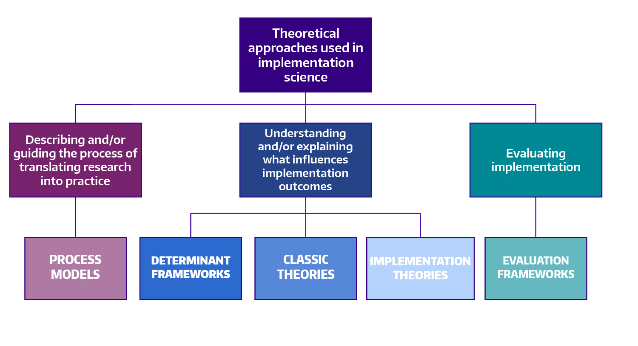
Proposed Methodology/Solution
Fig. 1: Sample Diagram
Notes:
The proposed methodology makes use of both qualitative and quantitative perspectives, and includes a broad array of approaches such as literature reviews, expert opinions, focus groups, and content validation. It also involves sophisticated assessment of construct validity including substantive and structural aspects.

Slide 17
Proposed Methodology/Solution (Continued)
The following sections are recommended for your synopsis presentation.
The statements included are suggestions/directions for you.
Please check with your Supervisors for optional sections, variations and additional sections that may be required for your Synopsis.

Slide 18
Results/Expected Outcomes
Contributions expected from your research efforts…
An explanation of how the research will address the needs shown in the Problem Statement.
May mention evaluation criteria/parameters for your research.
Most Expected Outcomes are written in either the future tense (will) or with the conditional (would).
Student can add some initial experimental results if any/applicable.

Slide 19
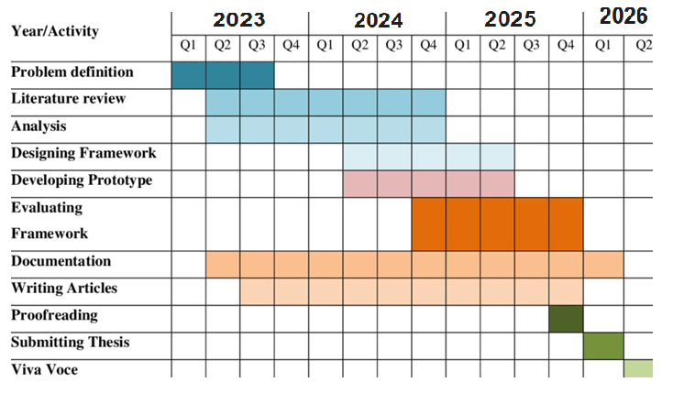
Work Schedule
Sample Table
Should aim to submit the thesis for examination by the end of the study period…
Would be excellent, if you could graduate by the end of the study period…
Should identify the milestones and deliverables in terms of a Gantt chart….
Add Proposed timeline in tabular form according to the research domain, different phases and timeline (Month and year) . Discuss with your supervisor.

Slide 20
Conclusion
Your first step when writing your conclusion should be to restate your research topic. ...
Restate the concept
Summarize the main points of your research.
Connect the significance or results of the main points.
Conclude your thoughts in terms of the significance of the study.
  Brief explanation of why this study is important…
  List the benefits, positive expected outcomes or innovative applications of knowledge…
Only 1 slide…

Slide 21
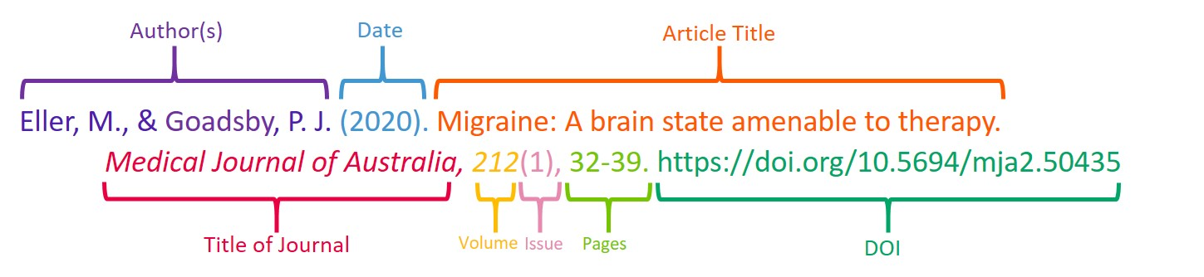
References
Only APA style is allowed throughout the presentation

Slide 22
THANK YOU
Q & A

