Slide 1
APPROVED THESIS TITLE
Student Name
(-ARID-)
MS(CS)
Supervisor:
Committee Members:
University Institute of Information Technology,
Pir Mehr Ali Shah Arid Agriculture University Rawalpindi.

Slide 2
Contents
Introduction
Literature Review
Problem Statement
Research Objectives
Research Questions
Research Methods
Proposed Solution
Results and Evaluation
Objective-wise Outcomes
Mapping Research Contributions with Objectives
Significance of Study
Conclusion and Future Recommendations
References
Publications
All headings must be added and properly explained to match presentation contents. Update the contents list according to your research work being presented.
Notes:
Readablility is most important in your presentation. All text and colors should be readable and should be uniformly balanced in size.

Slide 3
Introduction

Slide 4
Introduction
Background of the study
  Description of background to the topic…
  Why the topic is chosen...
  Introduction can be of 3-5 slides.
A figure/pictorial overview of the specific research domain gives a better idea to the audience.
The content in a slide is not in the form of a paragraph. There need to be bullet points, which you should be able to explain to the audience.
Do not just read the slides, make eye-contact with the audience to grasp their interest and understanding.
Only important references should be mentioned at the footer of the slide. All other references should be mentioned at the end of the presentation.

Slide 5
Introduction (Continued)
Important
  Text Readability is the most important thing. All text should be uniformly balanced among all slides. (Dey,2001).
  Make sure there are no spellings or grammatical mistakes in your presentation.
Figures
  Figures should be clear and readable. All figures should be labeled properly. Please do not resize images unevenly. A figure should be resized from both width and height.
  These are some guidelines. It should not be treated as instructions or rules. Consult your supervisor for details.
A. Dey, Understanding and using context, Personal Ubiquitous Computing. 5 (1) (2001) 4–7.

Slide 6
Introduction (Continued)
References
  Only most important references (Only in APA style) would be provided as footnote on a given slide. However, referencing guidelines should be consulted with supervisor (Dey,2001).
Tables
  Tables can be overflowed on different slides. Text within tables should be readable. Please do not skew text so much that it become unreadable.
A. Dey, Understanding and using context, Personal Ubiquitous Computing. 5 (1) (2001) 4–7.

Slide 7
Literature Review

Slide 8
Literature Review
Reference (Paper Title and Pub year only) | Identified Problems | Techniques | Tools | Contributions | Limitations
Context-Aware Sentiment Propagation Using LDA Topic Modeling on Chinese ConceptNet 2017
Add Precise text. Not too much text/details. Highlight your base paper(s). The LR table, such as number of columns and headings can be changed based on your research work.

Slide 9
Literature Review (Continued)
Reference (Paper Title and Pub year only) | Identified Problems | Techniques | Tools | Contributions | Limitations

Slide 10
Research gap(s) from Literature Review (Continued)
Give a brief critical review/outcome of the relevant literature..
Highlight the research gap(s), and Problematization…
Conceptual or theoretical framework if any…
Not more than 3 slides…

Slide 11
Problem Statement
Brief description of the problem under investigation…
Only 1 slide…
A problem statement is a short, clear explanation of identified issues or challenges that sums up from previous slides (literature review) what you want to change. It helps audience, supervisory committee members, to focus on the problem, why it's important, and who it impacts (Dey,2001).
Note: Discuss only the challenges that have been gathered from LR, not the solutions.
A. Dey, Understanding and using context, Personal Ubiquitous Computing. 5 (1) (2001) 4–7.

Slide 12
Research Objectives
Research objectives describe what your research project intends to accomplish.
They should guide every step of the research process, including how you collect data, build your argument, and develop your conclusions.
Your research objectives should be SMART-Specific, Measurable, Achievable, Realistic and Time-constrained.
Usually about 3 objectives... Only 1 slide

Slide 13
Research Questions
Research questions pinpoints exactly what you want to find out in your work? (Obj 1)
All research questions should be:
  Focused against every research objective
  Researchable using primary or secondary sources
  Feasible to answer within the timeframe and practical constraints
  Specific enough to answer thoroughly
  Complex enough to develop the answer over the space of a paper or thesis
  Relevant to your field of study and/or society more broadly
Write your research questions assimilated from your background and literature review…Only 1 slide

Slide 14
Methodology

Slide 15
Research Methods
Explain the research methods to be used in the study
Experimental/theoretical/fundamental research… (quantitative or qualitative or a combination)
How and where the study will be conducted
Data collection methods if data collection is involved including sample size
Ethical considerations if any..
Challenges and limitations
Note more than 2 slides

Slide 16
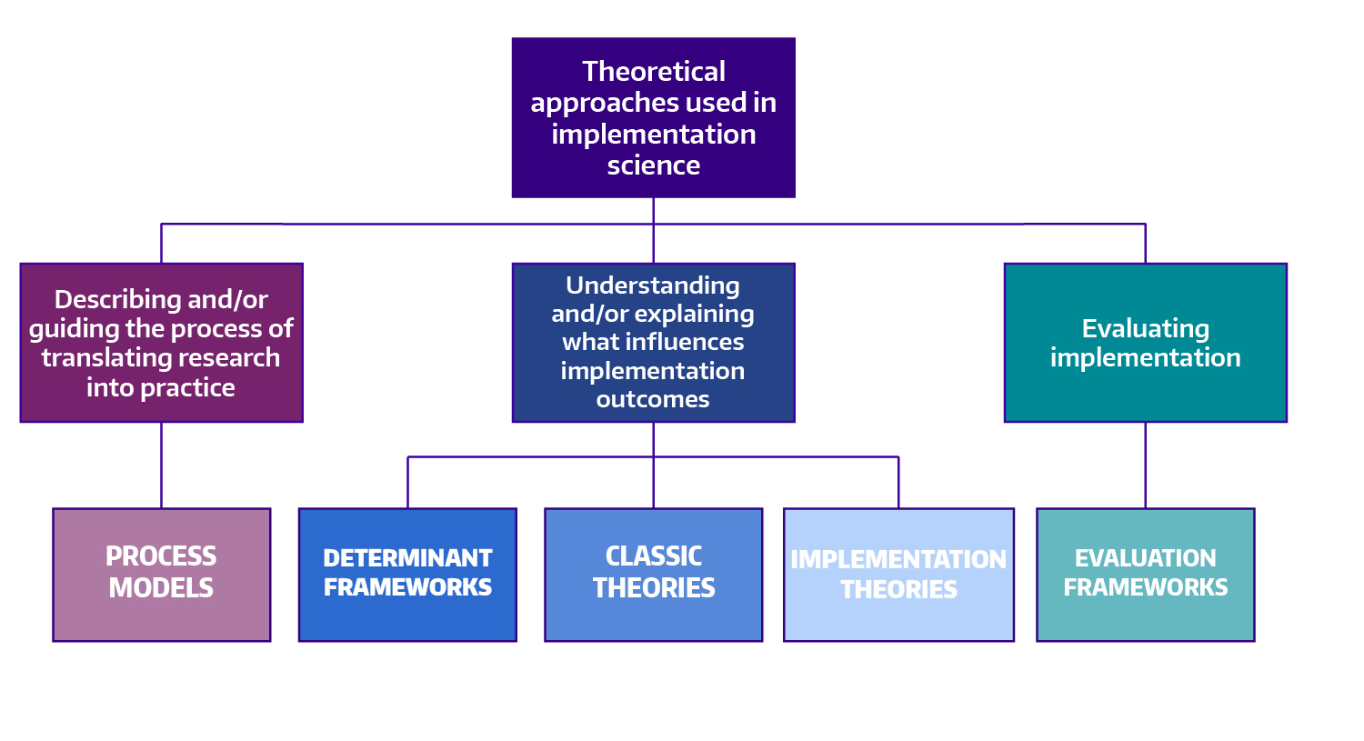
Proposed Solution
Fig. 1: Sample Diagram
Notes:
The proposed methodology makes use of both qualitative and quantitative perspectives, and includes a broad array of approaches such as literature reviews, expert opinions, focus groups, and content validation. It also involves sophisticated assessment of construct validity including substantive and structural aspects.

Slide 17
Proposed Solution (Continued)
The following sections are recommended for your thesis presentation.
The statements included are suggestions/directions for you.
Please check with your Supervisors for optional sections, variations and additional sections that may be required according to your Thesis.

Slide 18
Experimental Results and Evaluation
Results of your proposed approach/model/method for achievement of the objectives.
3-5 slides

Slide 19
Objective-wise Outcomes
Map the objectives with your outcomes/research contributions

Slide 20
Significance of Study
What is the significance of your study?
What is the societal impact of your research work?

Slide 21
Conclusion and Future Recommendations
Your first step when writing your conclusion should be to restate your research topic. ...
Restate the concept
Summarize the main points of your research.
Connect the significance or results of the main points.
Conclude your thoughts in terms of the significance of the study.
  Brief explanation of why this study is important…
  List the benefits, positive expected outcomes or innovative applications of knowledge…
Only 1 slide…

Slide 22
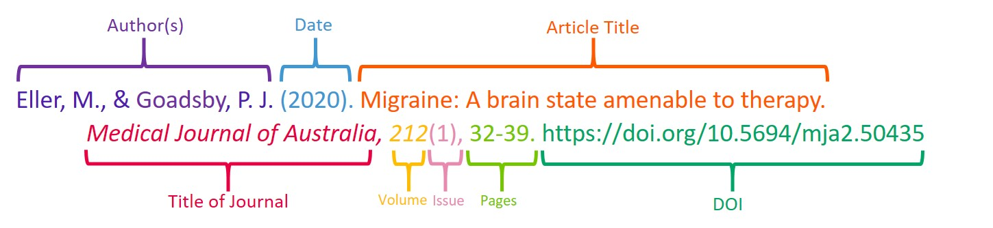
References
Only APA style is allowed throughout the presentation

Slide 23
Publications
Only APA style is allowed throughout the presentation

Slide 24
THANK YOU
Q & A

